Slide 1

Startup Investment Project
Safa Eladib - Mohamad Doughan - Jean-Denis Drane

Slide 2
INTRODUCTION & CONTEXT
In light of the global recession coupled with the sudden spread of the Covid-19 pandemic, a good friend of ours has unfortunately been forced to quit his job due to the economic and financial downturn that his company was facing. As a result, he thought that it would only seem reasonable in such dire times to venture in a personal business startup. Unluckily, our friend has no information on the global startup scene and has asked us to brief him on it so that he can go ahead and plan his next steps
Key features to include in our debrief:
Market analysis on the leading 10 countries in terms of total startups launched
Market analysis on the leading 10 countries in terms of aggregate fundings for startups
Market analysis on the distribution of stage funding for leading 10 countries
Trending startup categories
A close-up on one of the categories expected to skyrocket (E-Learning)

Slide 3
01
DATA ACQUISITION
02
WEB SCRAPING
03
DATA CLEANING
04
ANALYSIS & VISUALIZATION
05
CHALLENGES & OPPORTUNITIES
Notes:
Our study is composed of 4 main steps

Slide 4

01
DATA ACQUISITION
Dataset available in kaggle:
https://www.kaggle.com/arindam235/startup-investments-crunchbase#investments_VC.csv
DataSet reporting on startup businesses globally till 2014:
Shape: 54294 rows, 39 columns
Company information
Investment types
Investments rounds
Tools used:
Jupyter Notebook
Spyder

Slide 5
02
WEB SCRAPING
Web Scraping to update our data with startups after the year 2014
https://www.startupranking.com/
Limited our study on the top 200 startups
Cleaning and aggregating data
Complementing our analysis from initial dataset
Tools used:
Selenium
Jupyter Notebook
MySQL
Spyder

Slide 6
03
DATA CLEANING
Dropping all rows where the entire instances have a NAN value (> 5000 rows)
Stripping all leading and trailing white spaces
Creating a new DF with all startups that have duplicated name (~ 200 startups)
Dropped all duplicated names where they have the same Name, Homepage URL, and Country Code
Drop all rows where the instances inside Category List, Market, Funding Total usd, Country Code, Region, & Market
Amending the category list by adjusting the text string and sorting words alphabetically
Amending the total funding column and converting the resulting data into a Float type
Since we have total investment broken down into funding stages, it was a good practice to sum all funding stages for each startup and comparing the value with the Funding Total usd column
For every instance where the later is missing and the former has a value, replace the later with the former's
Checking that the null values in the 3 columns (founded_quarter, founded_year, founded_month) are at the same instances
Checked that all indexes in column founded_at where the value in NaN is a subset in the list of indexes for column founded_month where the value is NaN

Slide 7
03
DATA CLEANING
Function to study the correlation between the 'founded_at' and 'first_funding_at' to check whether we can replace the missing values in column (founded_at) with the values of (first_funding_at)
Check if all NaN instances in country and region are a subset of all NaN instances in City
For any missing country code, if we have another instance that has same region and a valid Area -> Replace missing country code with the valid one
Replacing missing values in the category list with values in market list
Resetting index

Slide 8
04
ANALYSIS & VISUALIZATION

Slide 9
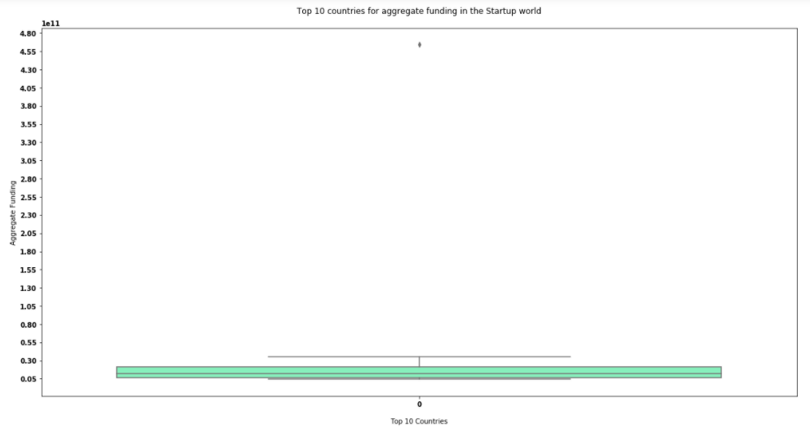

Slide 10
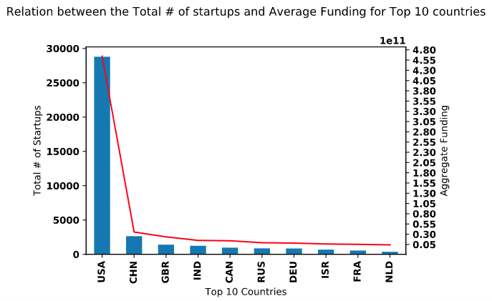

Slide 11
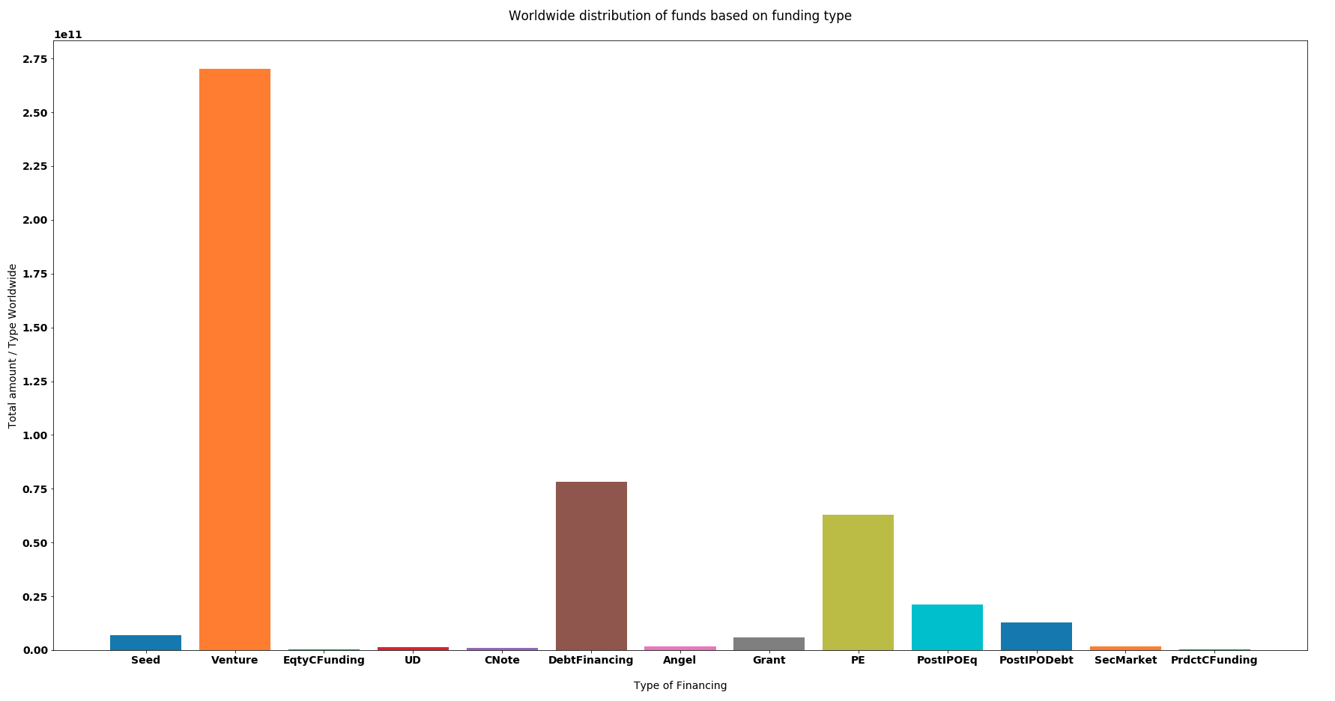

Slide 12
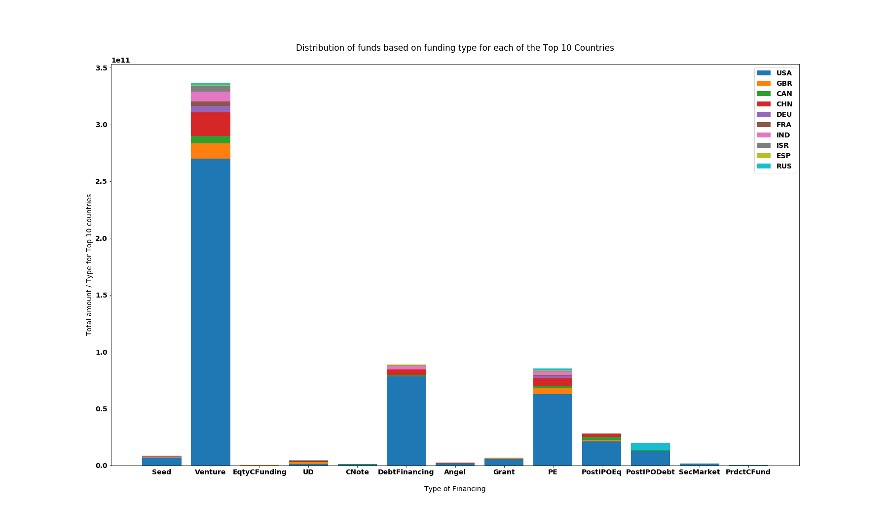

Slide 13
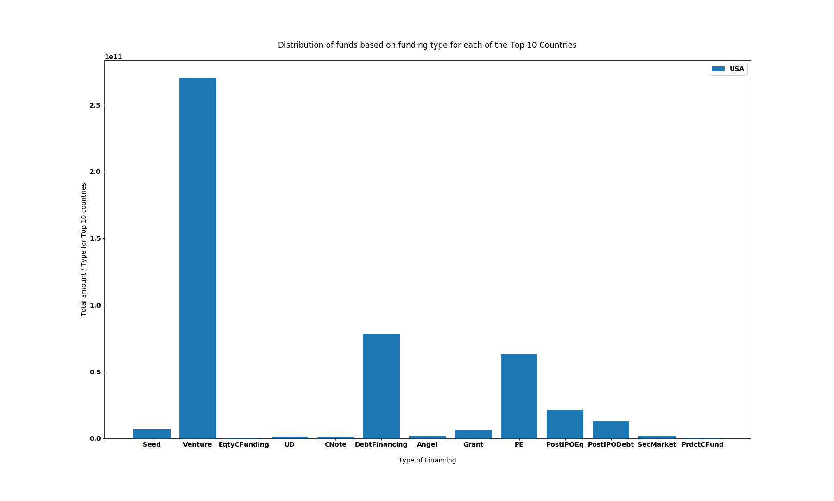

Slide 14
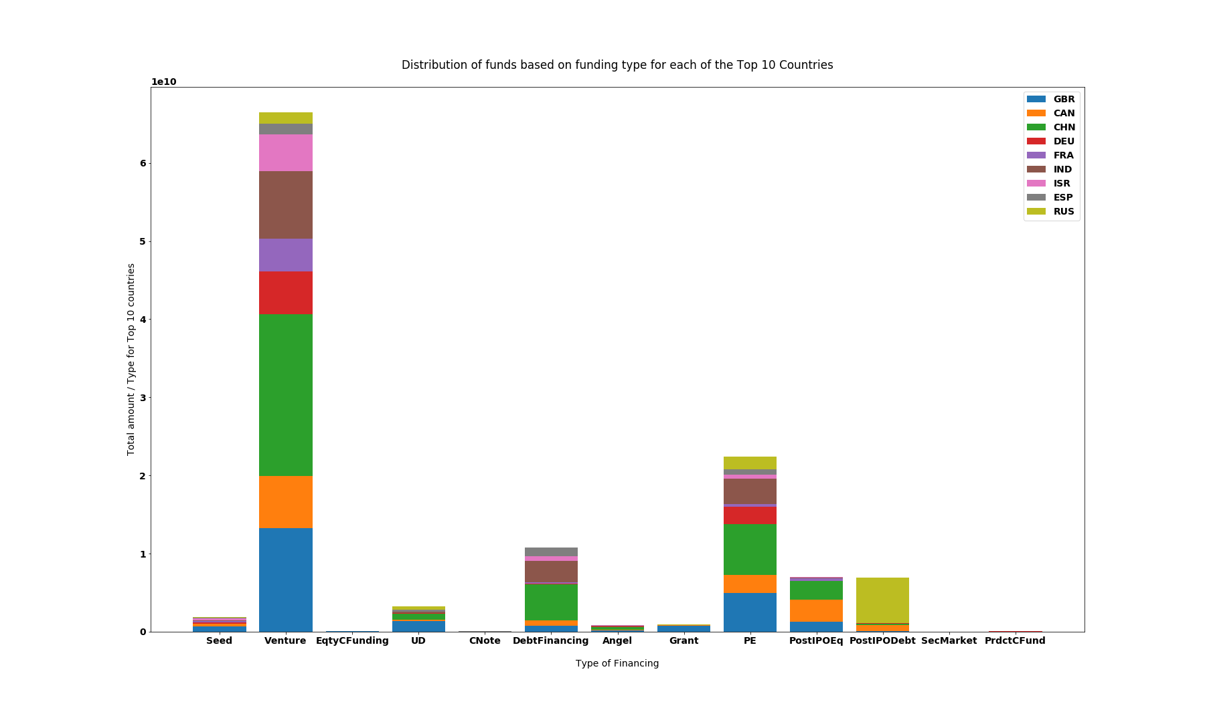

Slide 15
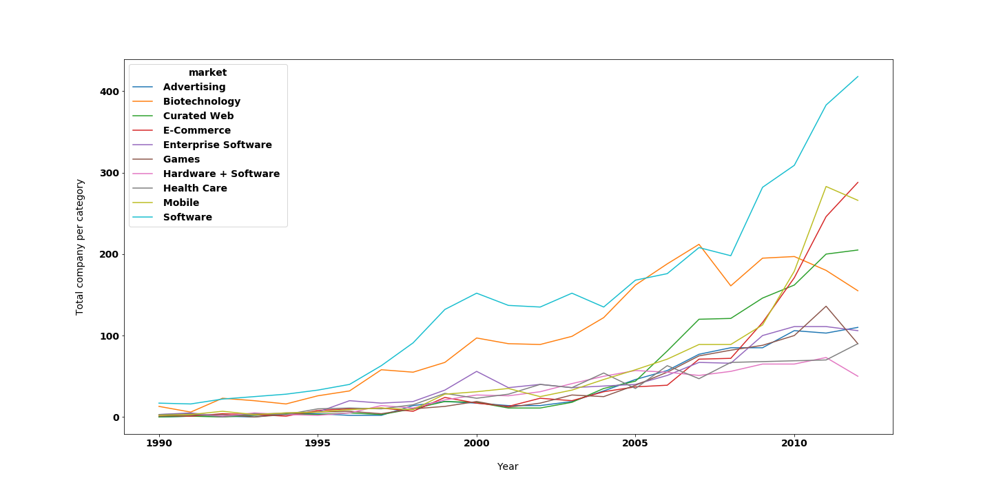

Slide 16
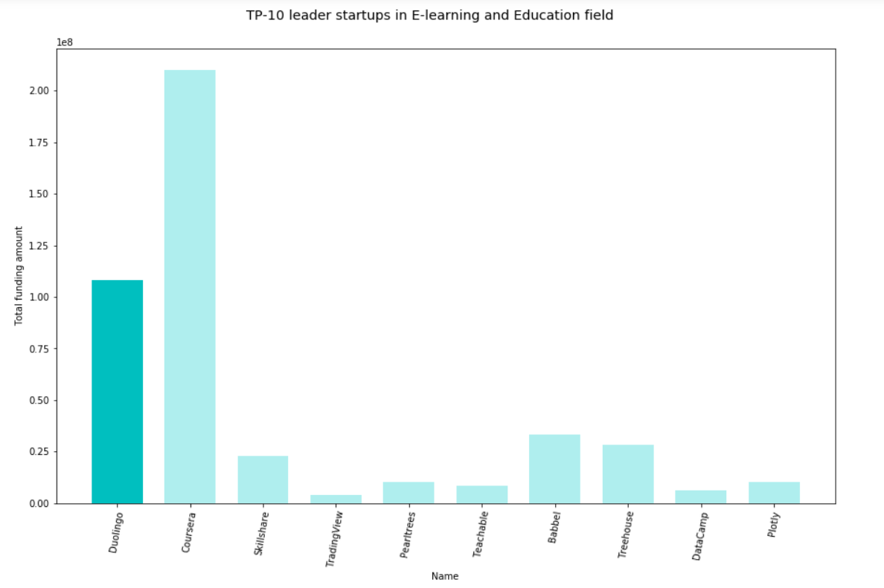
Third plot
MERCURY
VENUS
Mercury is the closest planet to the Sun and the smallest one in our Solar System—it’s only a bit larger than our Moon
Venus has a beautiful name and is the second planet from the Sun. It’s terribly hot—even hotter than Mercury
Notes:
This graph shows us the top 10 startups in e-learning market and the amount of funding they spend to reach actual level of success.

Slide 17
Challenges
&
Opportunities
All our knowledges on python and more...
Team work - Use of trello to organize tasks and plan the main milestones
Merging code
Time Constraints
Notes:
This project was an opportunity to us to apply fondamental knowledges in python programming. It allow us to improve our mastery of data pipeline, aggregation and analysis.
To manage the team work we used trello.
To merge code, i find that we were not very efficient on that. We choosed the rapid and easy way. By sending file in slack
Time constraint was the main challenge that we faced.

Slide 18
NOW LET SEE THE CODE

